Slide 1

CODE WIZARDS
KALPATARU INSTITUTE OF TECHNOLOGY-TIPTUR
HACKD - 2022
TEAM CODE WIZARDS HACKATHON ORGANISED BY DLithe

Slide 2

TEAM
1 .SANYAM SHARMA
2 .SAPTAMI S D
3 .SINCHANA S
4. SPOORTHY N
5. VARSHA T S
4 .Spoorthy N
5 .Varsha T S

Slide 3
PROBLEM STATEMENT: “TRANSPORTING TEMPERATURE-SENSITIVE PRODUCTS, FROM FOOD TO VACCINES POSES A RISK. THE IMPROPER HANDLING DURING THE COLD CHAIN TRANSPORT SPOILS FOOD AND RENDERS MEDICINES INEFFECTIVE. IT MAKES THE PRODUCTS LOSE THEIR POTENCY AND BECOME LESS USABLE” .
1.TRACKING INCAPABILITIES
2.MONITORING DEVICES
3.HIGH MAINTAINANCE COST

Slide 4
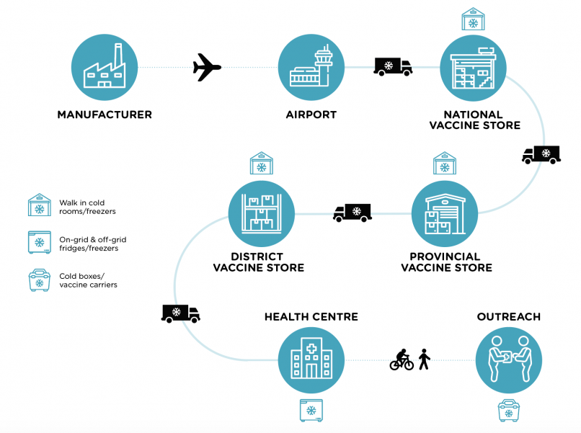
WHAT IS COLD CHAIN?

Slide 5
MAJOR PROBLEMS FACED IN COLD SUPPLY CHAINS
Damaged cooler/freezer doors
Condensation
Microbial Growth
Excessive Heat Exposure
Damaged Goods
Packaging Problems
Disrupted temperature control
Transport delays and breakdowns
Lacking Infrastructure
Higher cost

Slide 6
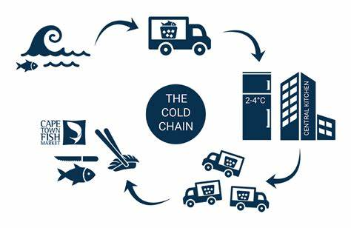
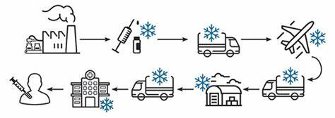
CHALLENGE - IOT ENABLED RISK MONITORING SYSTEM FOR MANAGING COLD SUPPLY CHAIN RISKS

Slide 7
IDENTIFIED SOLUTION: MONITORING DEVICE ALONG WITH THE STORAGE AND SHIPMENT IN COLD SUPPLY CHAIN
AUDITING
Auditing and logging data is the utmost necessary in this supply chain.
TRACKING
MAINTAINANCE
Tracking must be done in a proper and efficient way.
In the cold storage and the supply, temperature sensitive products are to be maintained accordingly.
COST
MONITORING
Cost must be reduced and best services should be provided.
Temperature/humidity sensing devices are needed to be installed for efficiency and the quality.

Slide 8
MONITORING DEVICES THROUGHOUT THE COLD SUPPLY CHAIN
FEATURES OF OUR PROTOTYPE
TEMPERATURE SENSING PROTOTYPE
TRACKING DEVICE
DATA LOGGING DEVICE
COST EFFECTIVE (AFFORDABLE)
SIMPLE AND UNDERSTANDABLE DEVICE

Slide 9
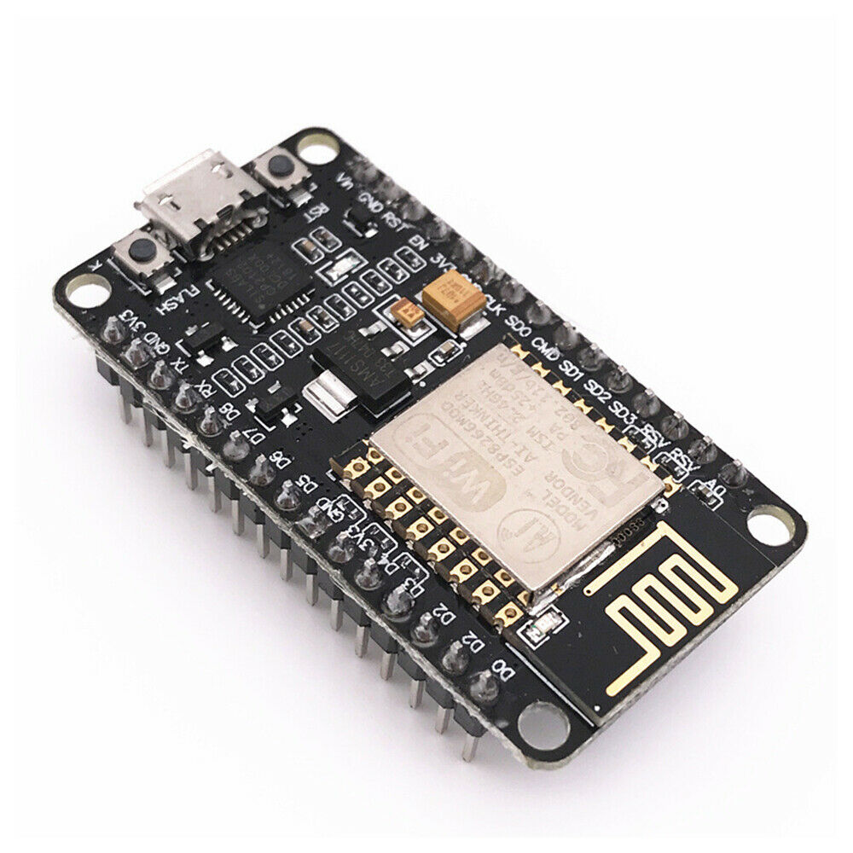
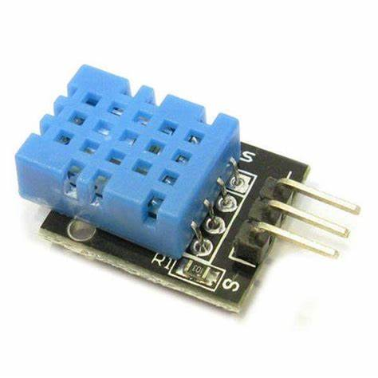
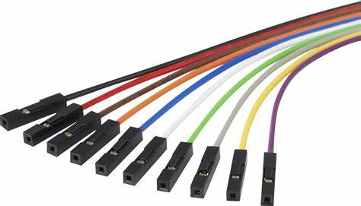
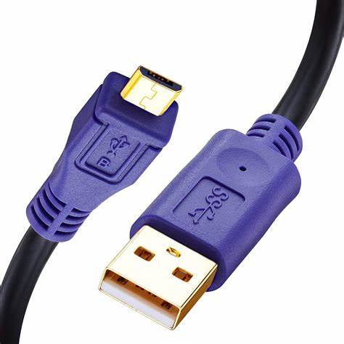
COMPONENTS USED IN OUR PROTOTYPE – HARDWARE PART
ESP 8266 WIFI MODULE
DHT 11 SENSOR
ESP 8266 WIFI MODULE
DHT 11 SENSOR
JUMPER WIRES
MICRO USB CABLE
JUMPER WIRES
MICRO USB CABLE

Slide 10

SOFTWARE PART
ARDUINO IDE
CAYENNE.MYDEVICES WEB
MICRO USB CABLE

Slide 11
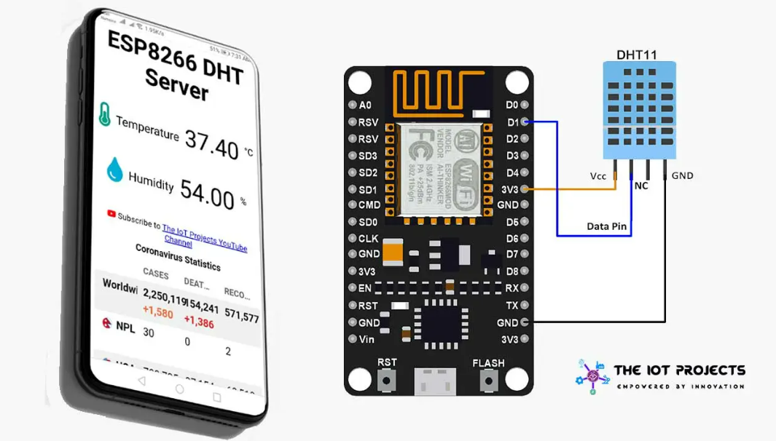
Our Prototype
Temperature/humidity sensor ESP 8266 and DHT 11 sensor through IoT

Slide 12

Summary about our prototype
We have assembled the components and connected accordingly, this prototype is used to detect the temperature/ humidity. We used ice packs to create a false cold environment inside the polystyrene box. Temperature is recorded and displayed in the system and data is logged to the web through cayenne web application using Arduino IDE.

Slide 13
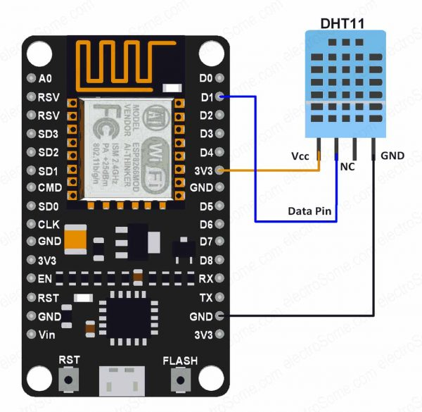
PIN DIAGRAM

Slide 14
Brief explanation and Applications of our Prototype
Here, Arduino IDE is used to burn the code into the ESP 8266 (Wi-fi module) and C programming language is used.
In our prototype, we can maintain and detect the temperature inside the box.
To implement IoT , we are going use ESP 8266 (Wi-Fi module) for automated cloud computing. In this application , we can record the temperature and fetch later.
CAYENNE is a web-application used in this aspect for cloud computing.

Slide 15




OUR PROTOTYPE – OUR SOLUTION
SUPPLY CHAINS
COLD STORAGE

Slide 16
ADVANTAGES OF OUR PROTOTYPE
Can be used by anyone who wishes to use the cold supply chain.
B
TRACKING
Easily tracks the shipment and alerts.
A
. SIMPLE
C
AUDITING
E
E.
TEMPERATURE SENSOR
Temperature sensing device is implemented through which temperature/humidity can be recorded
D
DATA LOGGING
Audits the data throughout the shipment.
Entering of the collected data through the sensor.

Slide 17

CONCLUSION
Transporting temperature-sensitive products, from food to vaccines poses a risk. The improper handling during the cold chain transport spoils food and renders medicines ineffective. It leads to concerns about the safety of consuming the products. In today’s logistics world, real-time tracking of the cold chain supply chain is in demand along with the international rollout of cold chain temperature monitoring with the IoT Technology.
01
We have tried to develop a prototype which can be implemented as a device with the application of more advanced components. This can be further implemented in larger scale with sufficient investment.
02
The team had a lot of insights in making this project. We learned a lot of things and we are grateful for the opportunity to work on this hackathon project. Through this we have a sufficient knowledge on cold supply chains and its applications.
03

Slide 18


